Slide 1
Course 227 Lab 6 – Waveguide Structures CST Microwave Studio
Dr Harry Marks
h.marks@lancaster.ac.uk

Slide 2
Objectives:
Become more familiar with CST Microwave Studio by simulating new structures:
Be able to identify different modes at the input port.
Finding the cut-off frequency using CST and via calculation.
Calculate Impedance.

Slide 3
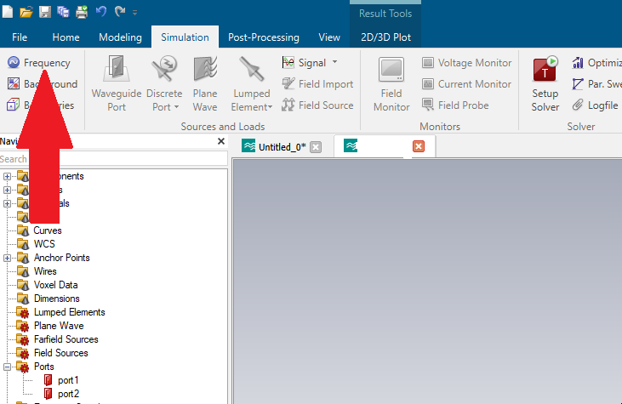
Set up a waveguide with inner dimensions a = 4mm, b = 2mm. Set the frequency range as 95-105 GHz. This can be done by clicking on the tab shown below:

Slide 4
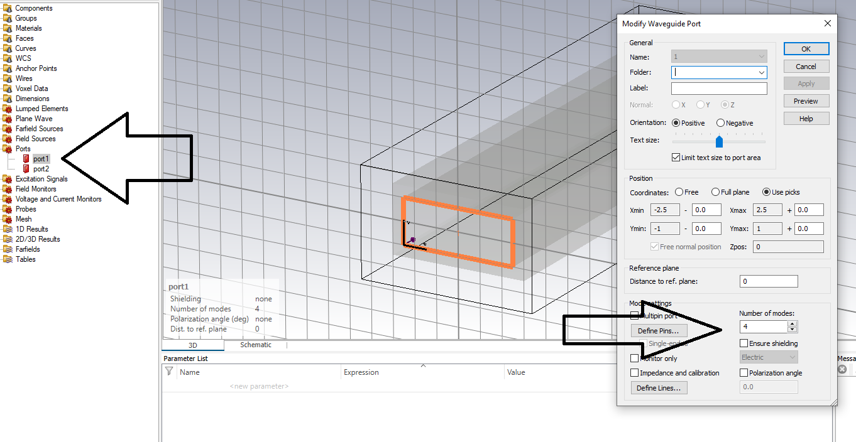
By clicking on port1 from the left hand menu a pop-up appears. Here you can select the number of modes which can be excited at this port.

Slide 5
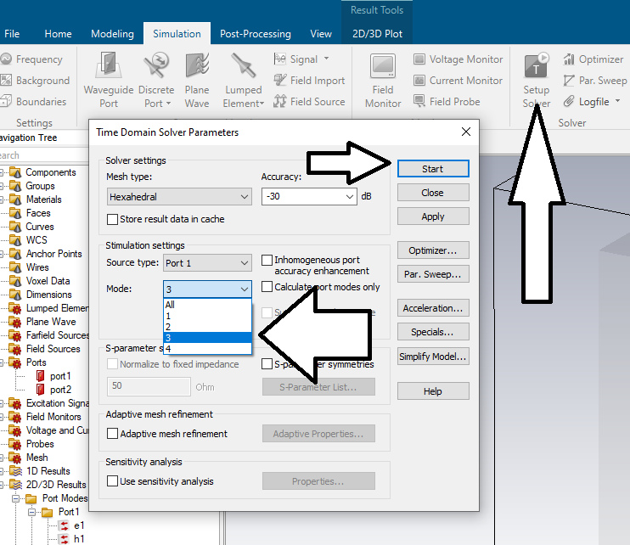
Reminder: Click on Setup Solver to run the simulation. You can choose which port mode you want to excite. Then click start.

Slide 6
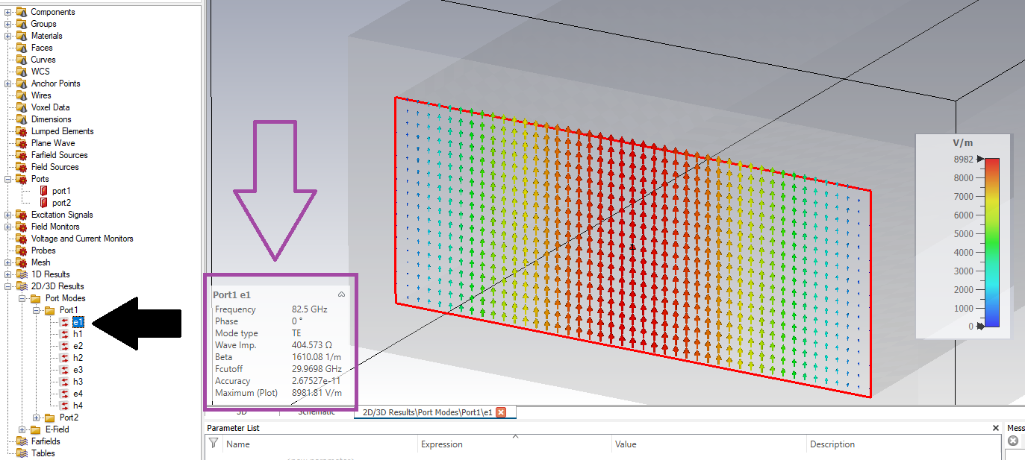
TE10

Slide 7
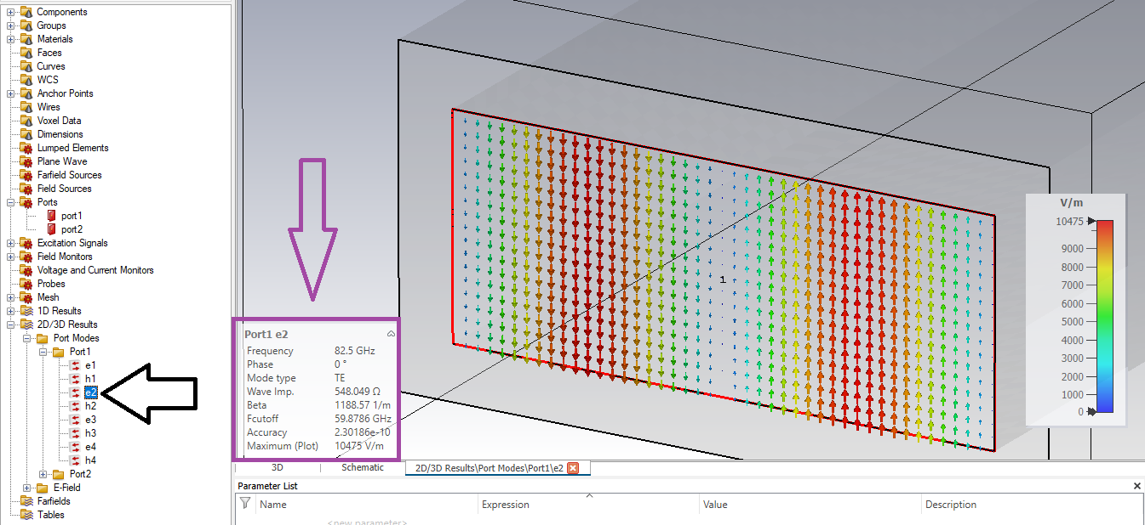
TE20

Slide 8
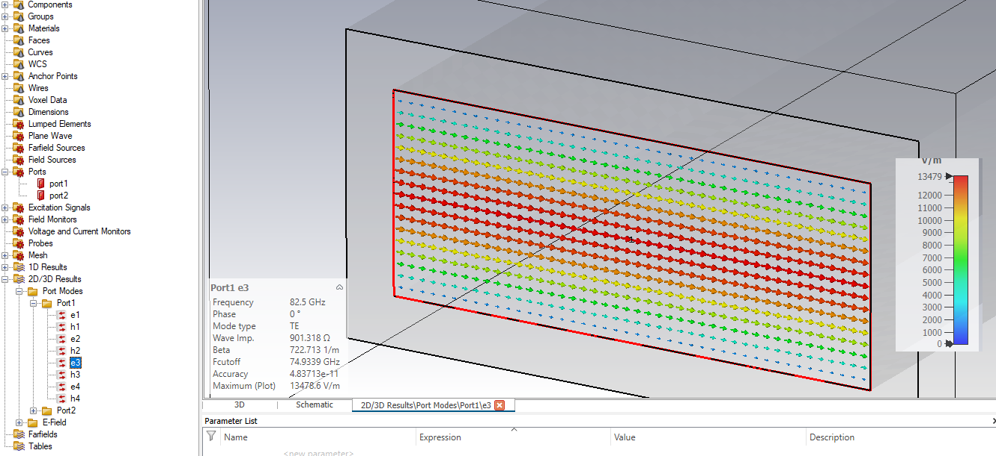
TE01

Slide 9
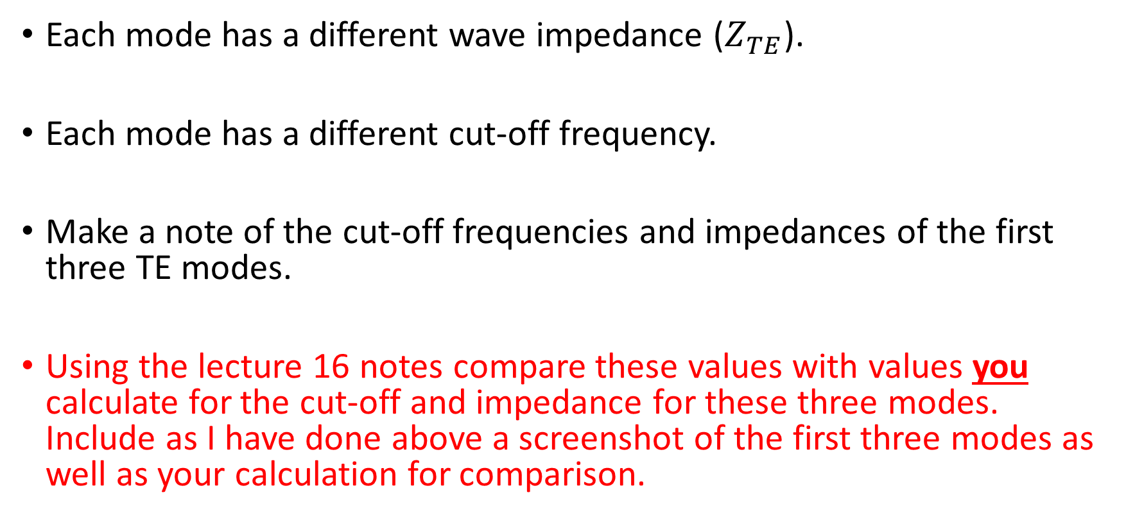
Note the details in the purple square in slides 6 and 7.
Each mode has a different wave impedance ($Z_{TE}$).
Each mode has a different cut-off frequency.
Make a note of the cut-off frequencies and impedances of the first three TE modes.
Using the lecture 16 notes compare these values with values you calculate for the cut-off and impedance for these three modes. Include as I have done above a screenshot of the first three modes as well as your calculation for comparison.

Slide 10
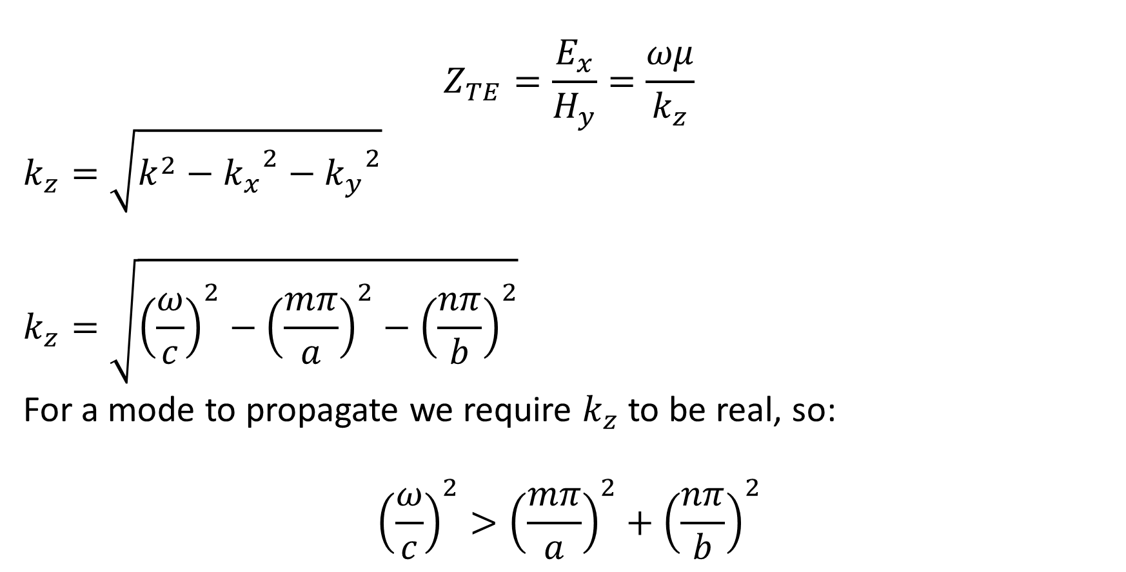
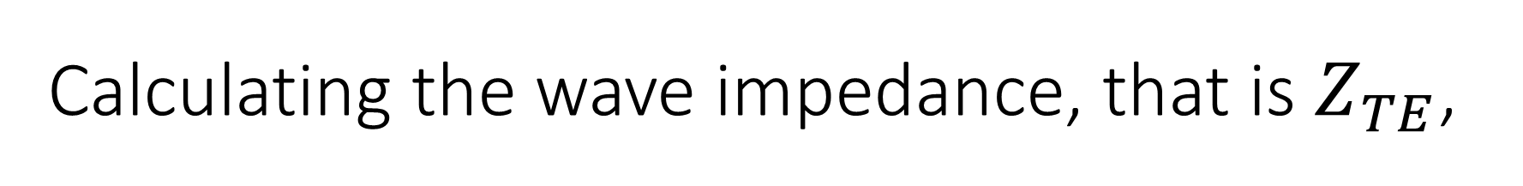
Calculating the wave impedance, that is $Z_{TE}$,
$$Z_{TE}=\frac{E_{x}}{H_{y}}=\frac{ωμ}{k_{z}}$$
$$k_{z}=\sqrt{k^{2}−{k_{x}}^{2}−{k_{y}}^{2}}$$
$$k_{z}=\sqrt{{\left(\frac{ω}{c}\right)}^{2}−{\left(\frac{mπ}{a}\right)}^{2}−{\left(\frac{nπ}{b}\right)}^{2}}$$
For a mode to propagate we require $k_{z}$ to be real, so:
$${\left(\frac{ω}{c}\right)}^{2}>{\left(\frac{mπ}{a}\right)}^{2}+{\left(\frac{nπ}{b}\right)}^{2}$$

